Slide 1
Visualizing and analyzing hinode xrt metadata
Greg Woelki

Slide 2
Overview
Hinode XRT
XRT Pointing Visualization/Planning Tool
XRT Flare Imaging Performance Analysis

Slide 3
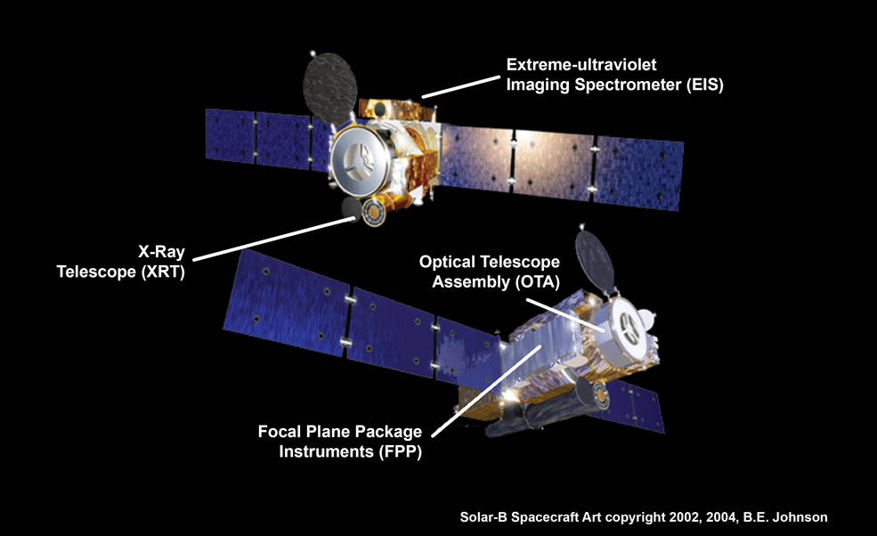
Hinode
http://www.nasa.gov/sites/default/files/styles/full_width/public/thumbnails/image/hinode_spacecraft_0.jpg

Slide 4
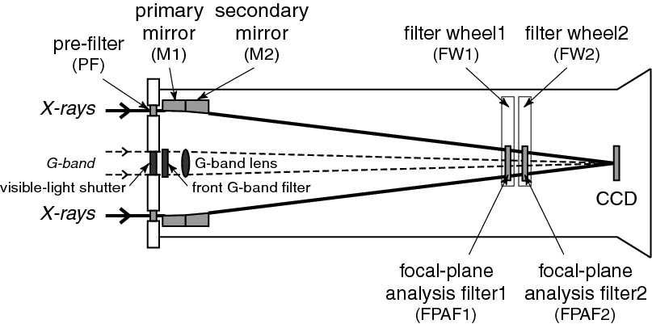
XRT
http://inspirehep.net/record/877387/files/fig_optical_elements.png

Slide 5
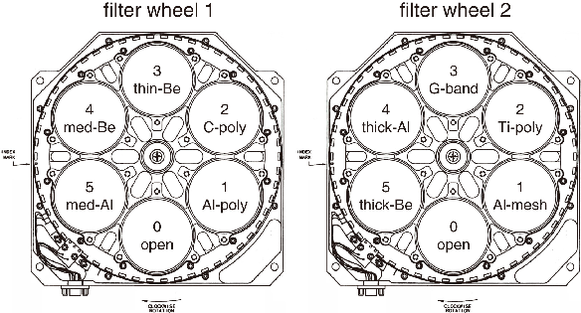
XRT
http://inspirehep.net/record/877387/files/fig_FW.png

Slide 6
XRT
Synoptics
Pointing plans – tracking
Flare Detection Patrol Images
Flare Response Images
Focus Mode
Eclipse season

Slide 7
XRT Pointing Visualization/Planning Tool
Python 2.7
Iterates through synoptics
Displays synoptics with additional data:
Pointing fields of view
Flare response field of view and number of images
Flares – labeled by class
Frames assembled into 1 FPS video for help planning

Slide 8
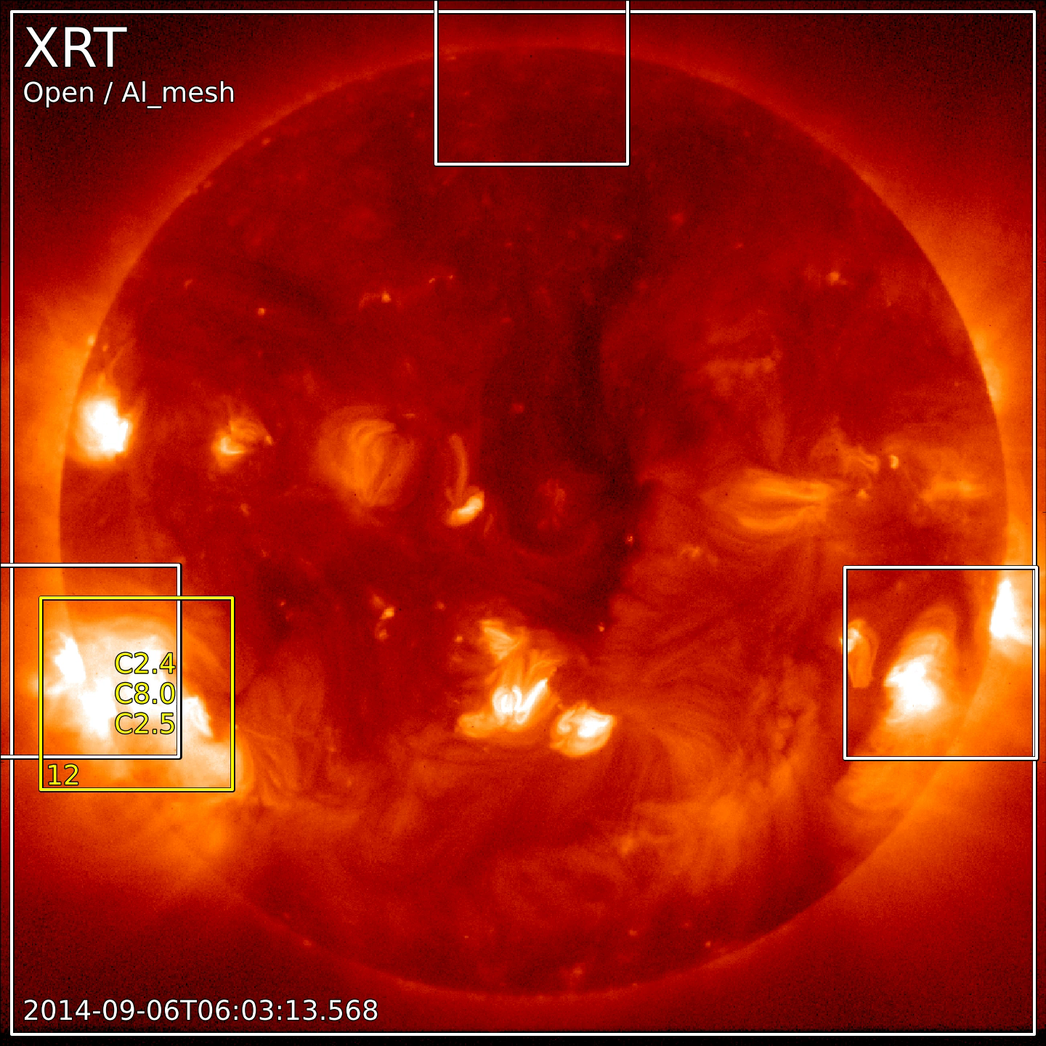

Slide 9
Analysis of XRT Flare Imaging Performance
First analyzed performance with respect to the location of flares
Imaging probability curves
STEREO
FLD response likelihood vs. location
FLD response likelihood vs. flare class
Focus Mode
Eclipse Focus Mode
Normal Mode
FLD failure reasons vs. location
FLD failure reasons vs. class

Slide 10
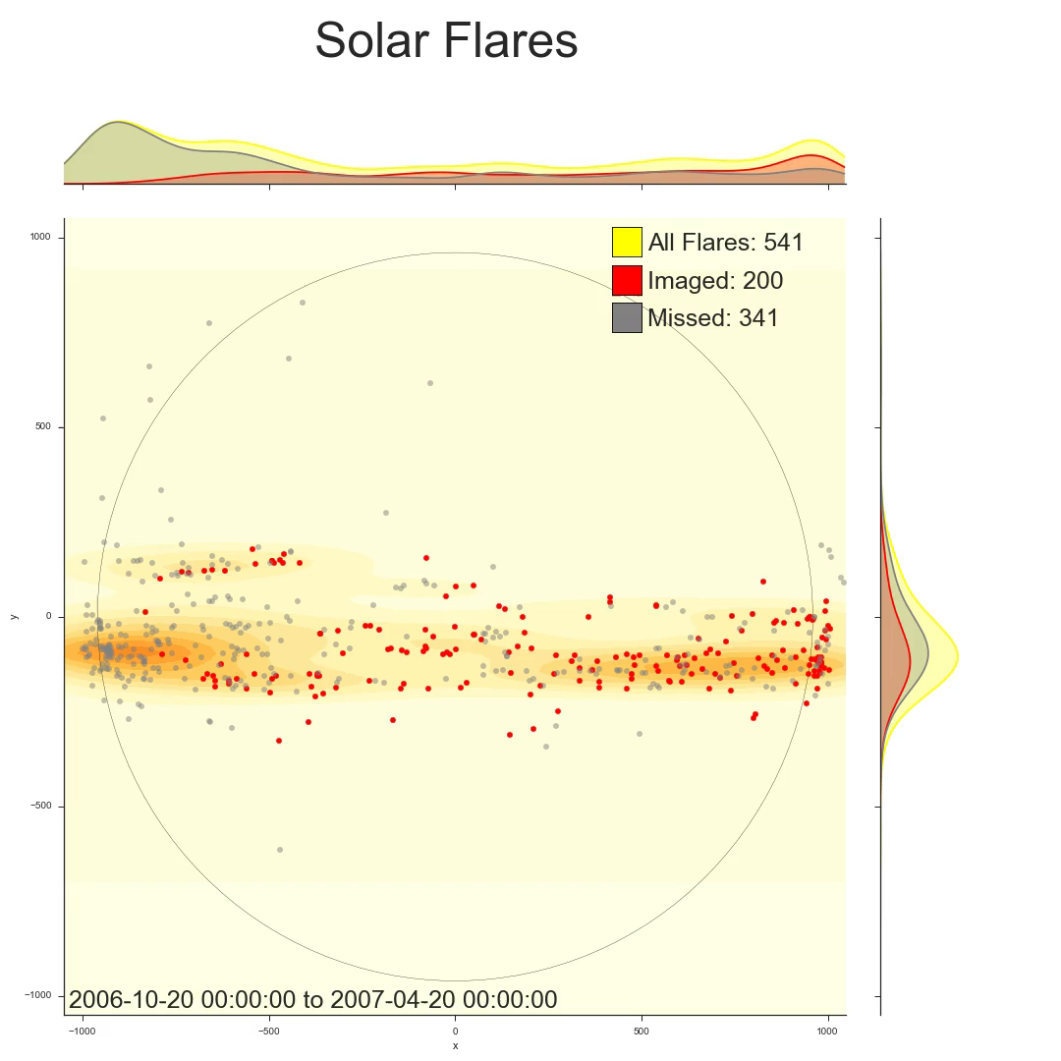
E
W

Slide 11
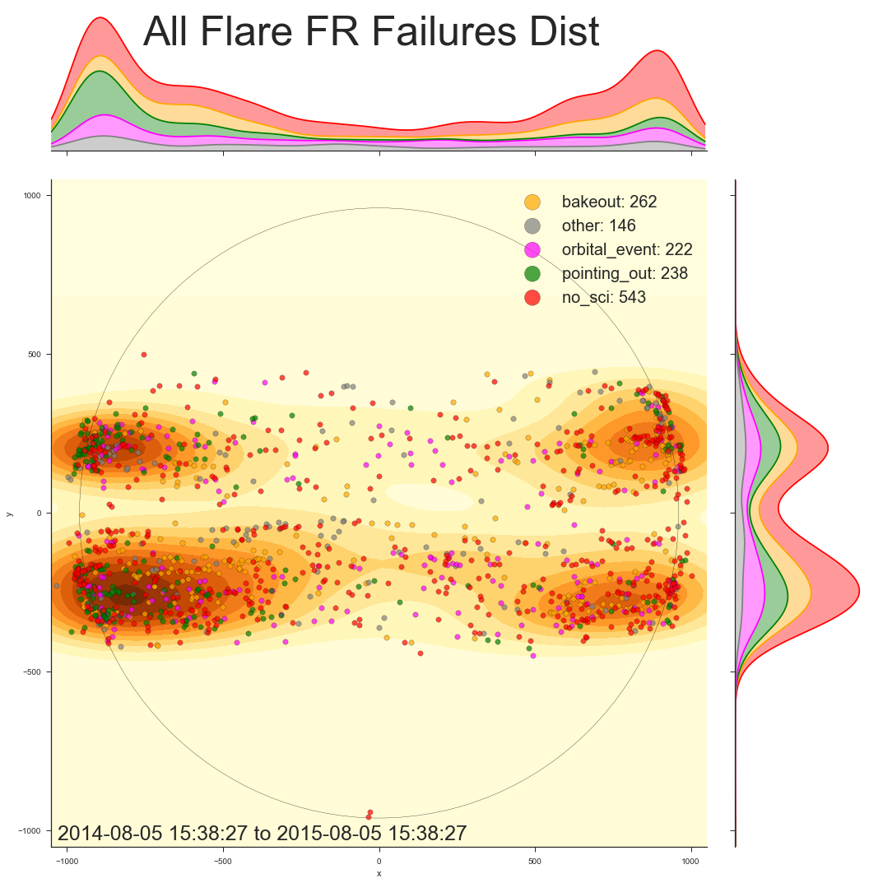
analysis

Slide 12
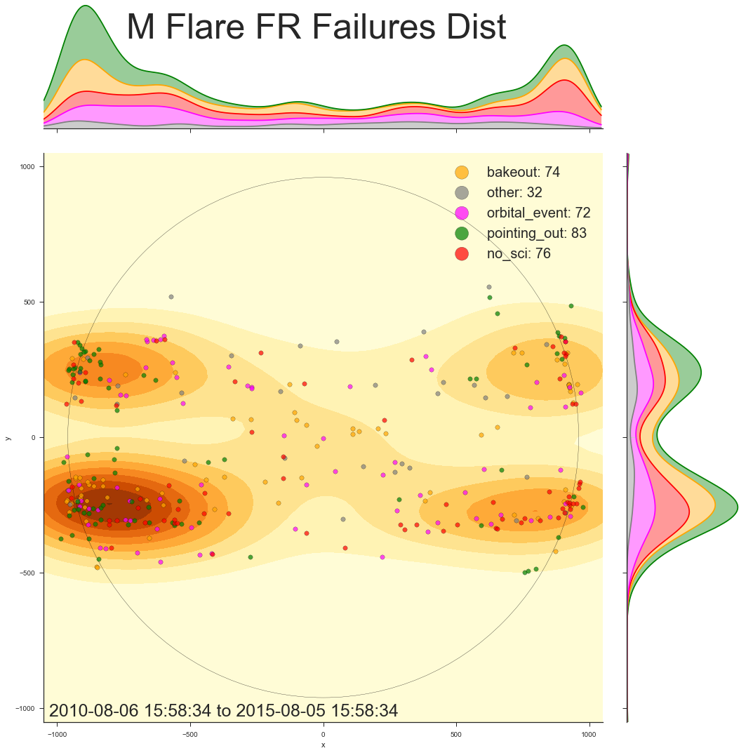
Analysis

Slide 13
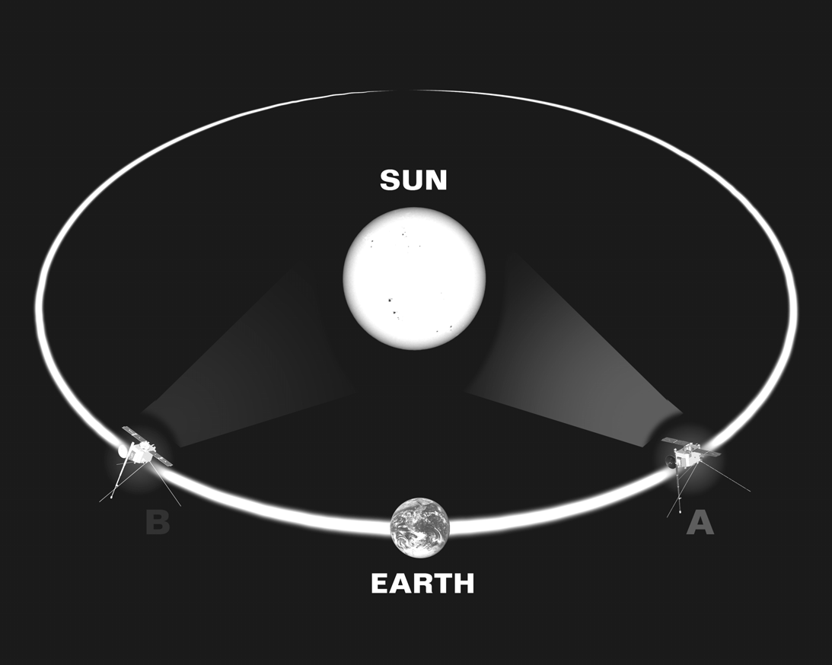
STEREO
http://cse.ssl.berkeley.edu/stereo_solarwind/img/missionsFolder/STEREO_orbit.bmp
Notes:
STEREO is a mission that has potential to help fix the east limb disparity. In 2006, two satellites (named A and B for “Ahead” and “Behind” respectively) were launched into highly eccentric orbits around the Earth. These orbits were precisely calculated so that, near the apogee of their orbits, they received gravity assists from the moon, launching STEREO A into an orbit around the sun slightly closer than the Earth’s and STEREO B into a slightly more distant orbit. By Kepler’s Third Law, it follows that STEREO A orbits the sun more quickly than the Earth, while STEREO B does so more slowly. Therefore, from a geocentric perspective, the two satellites “fan out” around the sun in each direction. This means that the satellites can provide stereoscopic data of events on the sun, which, among other things, can allow for what, if only viewed from the Earth, would be ambiguous geometries to be fully constrained. As far as Hinode is concerned, however, the value of the STEREO mission is that, at the proper orbital positions around the sun, the satellite on the eastern side of the sun can give the planners information about any active regions are approaching the east limb. In theory, this intelligence should improve flare detection performance on the east limb. STEREO B had a useful view of the eastern hemisphere of the sun from early 2009 until early 2013, while STEREO A will have such a view in the coming years (2015 was the year in which the satellites crossed behind the sun. STEREO B is currently unresponsive, but STEREO A is operational). If STEREO data was used effectively on the first pass around the sun, it should be apparent in the flare capturing performance of XRT on the east limb during that time period.

Slide 14
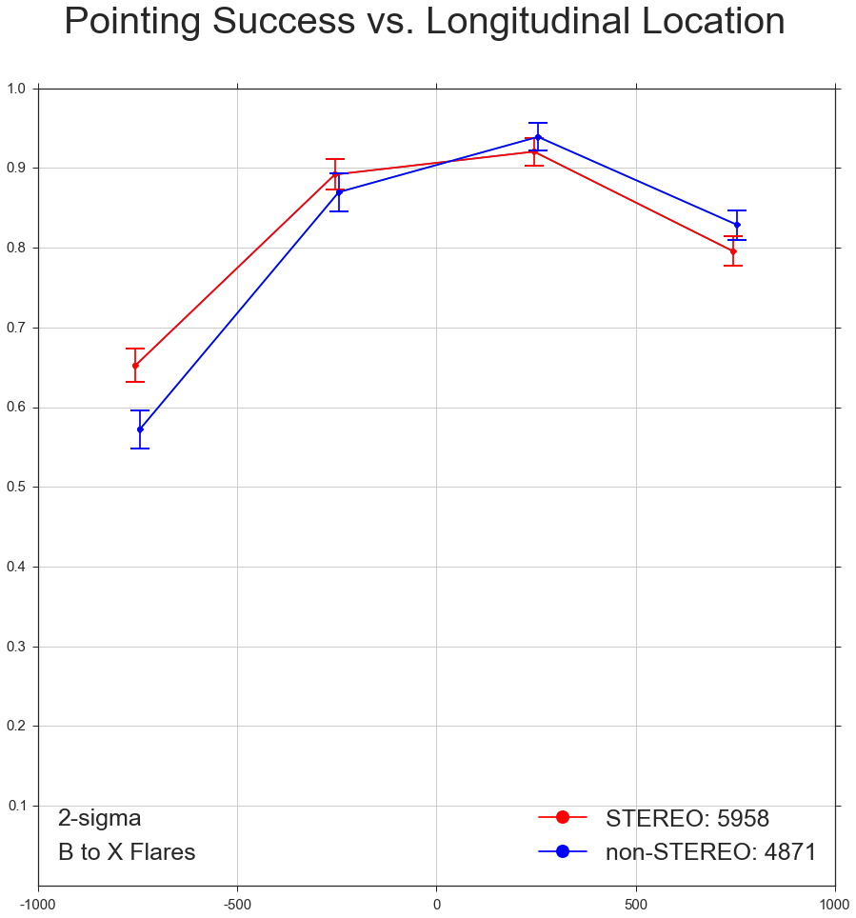
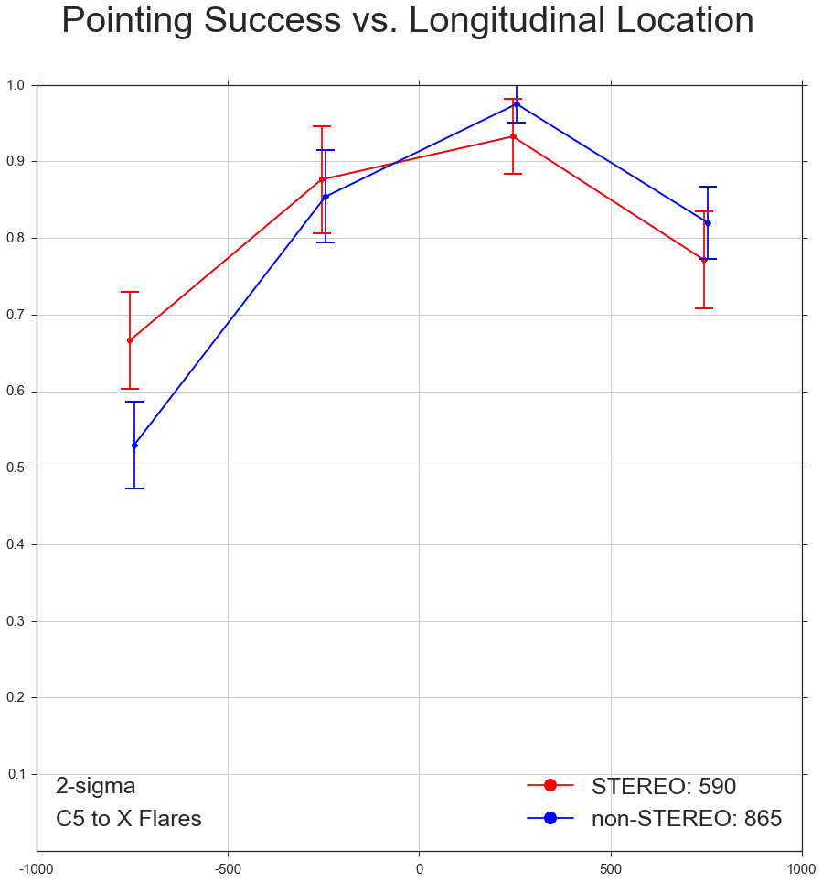
STEREO Analysis
Notes:
I went through several iterations in my analysis of of the effect of the STEREO mission on XRT flare imaging performance. I defined the “STEREO Era” to be from 2009-02-01 to 2013-03-01, approximately the period in which STEREO B’s orbit was between 45 and 135 degrees offset from the Earth’s. For comparison, I used 2013-03-01 to the present as the “non-STEREO Era.” My first few attempts at analysis were flawed such that random events -- such as when 20 flares rated C5 and higher occurred during a single CCD bakeout in 2013 – had too much of an effect on the results. My best solution to this problem was actually to ignore whether or not XRT imaged the flare in question, but rather to use Hinode pointing file information to determine whether the flare occurred within the field of view of the CCD, that way phenomena such as bakeouts, orbital events, and other events that hinder XRT’s performance would not impact the result. Sometimes, however, Hinode points certain places without even the intention for it to be a good FOV for XRT, such as during certain calibration routines or events like momentum wheel maneuvers. Flares that occurred during situations like those are filtered out in this analysis because they do not reflect the ability of the planners to point based on expected solar activity. These graphs were the results of this final iteration of my analysis. They depict the proportion of flares in each region that occurred within the FOV of XRT’s CCD. The left graph is for flares of class B and higher and the right one for flares rated C5 and stronger. Both graphs show a statistically significant increase in east limb performance during the STEREO Era. For flares of class B and higher, there was a small, but statistically significant at a level of 2-sigma, drop in performance on the west limb. However, not only is it minor, but we cannot say with any confidence that such an effect persists into the imaging of more powerful, more scientifically interesting flares. This analysis seems to indicate that the Hinode planners performed better in deciding when to aim at the east limb during the so-called STEREO era, suggesting that the mission did improve flare capturing performance. STEREO A will move into a good position for viewing the east limb in the next few years, and this analysis suggests that it will be worthwhile for Hinode planners to use its data to inform their decisions.

Slide 15
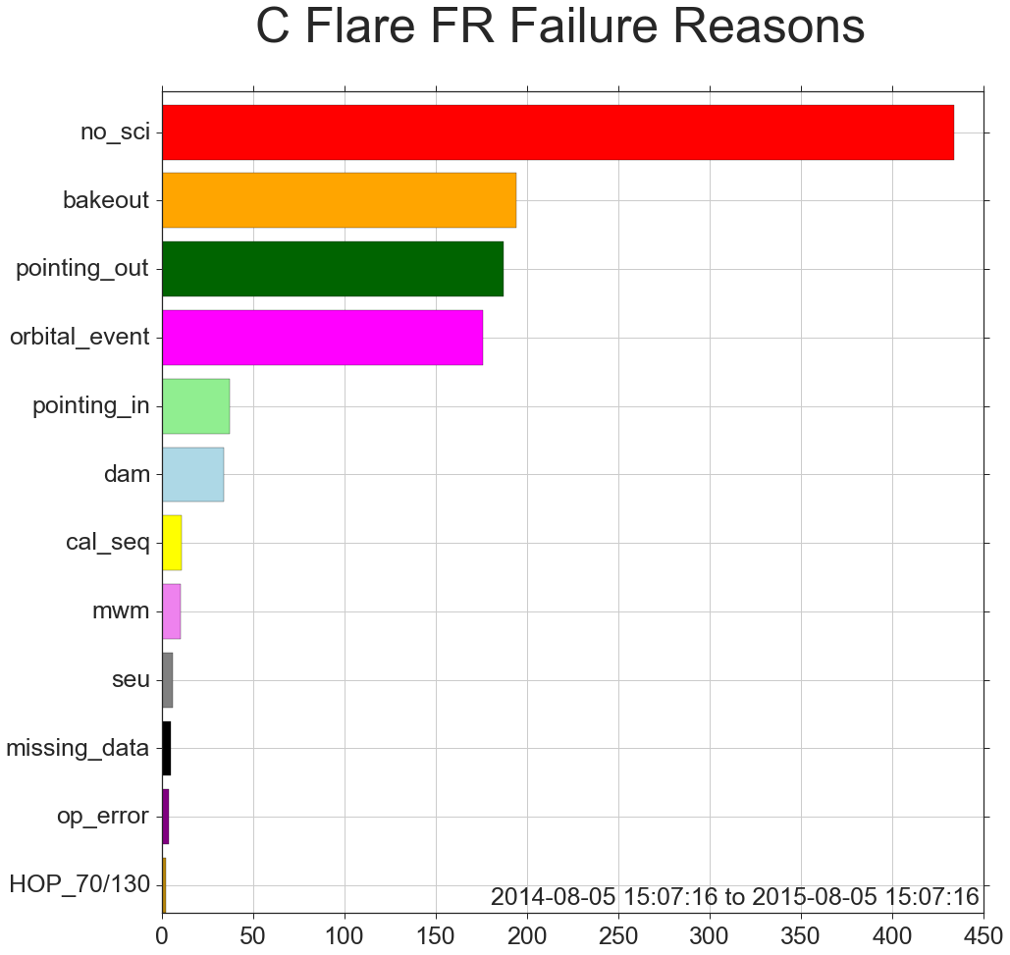
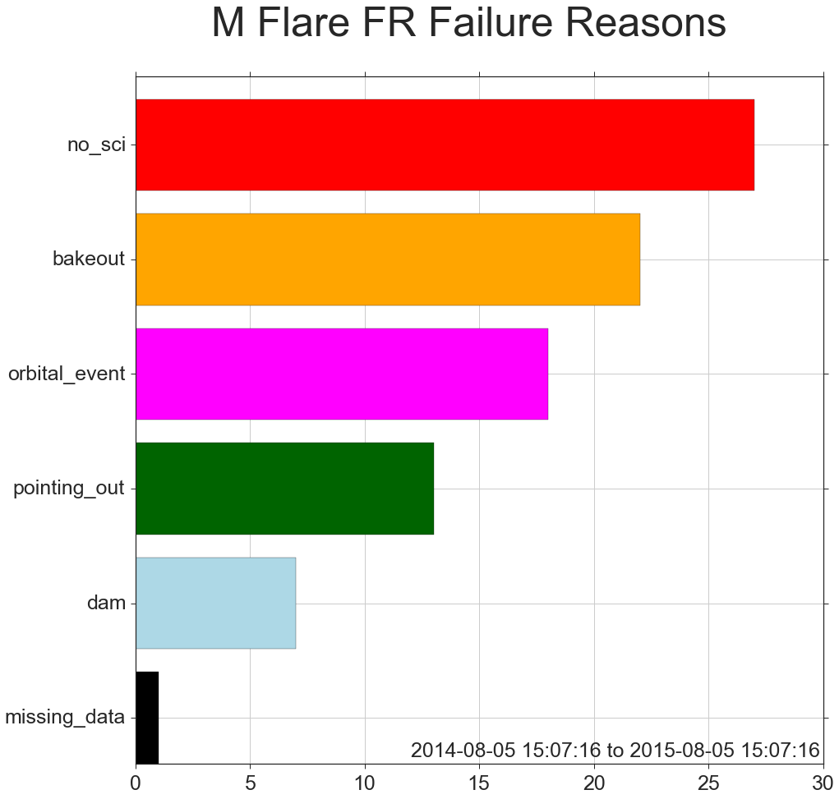
Fld failure analysis
Notes:
These plots show the frequency with which different reasons for flare detection failure occur. These graphs very clearly show that the largest cause for FLD failure is quite simply when no scientific observations are planned. A large portion of this category can be assigned to CCD bakeouts, the second most common reason depicted on these graphs. There are only two other major reasons, orbital events like eclipses or regions of high radiation and pointing failures.

Slide 16
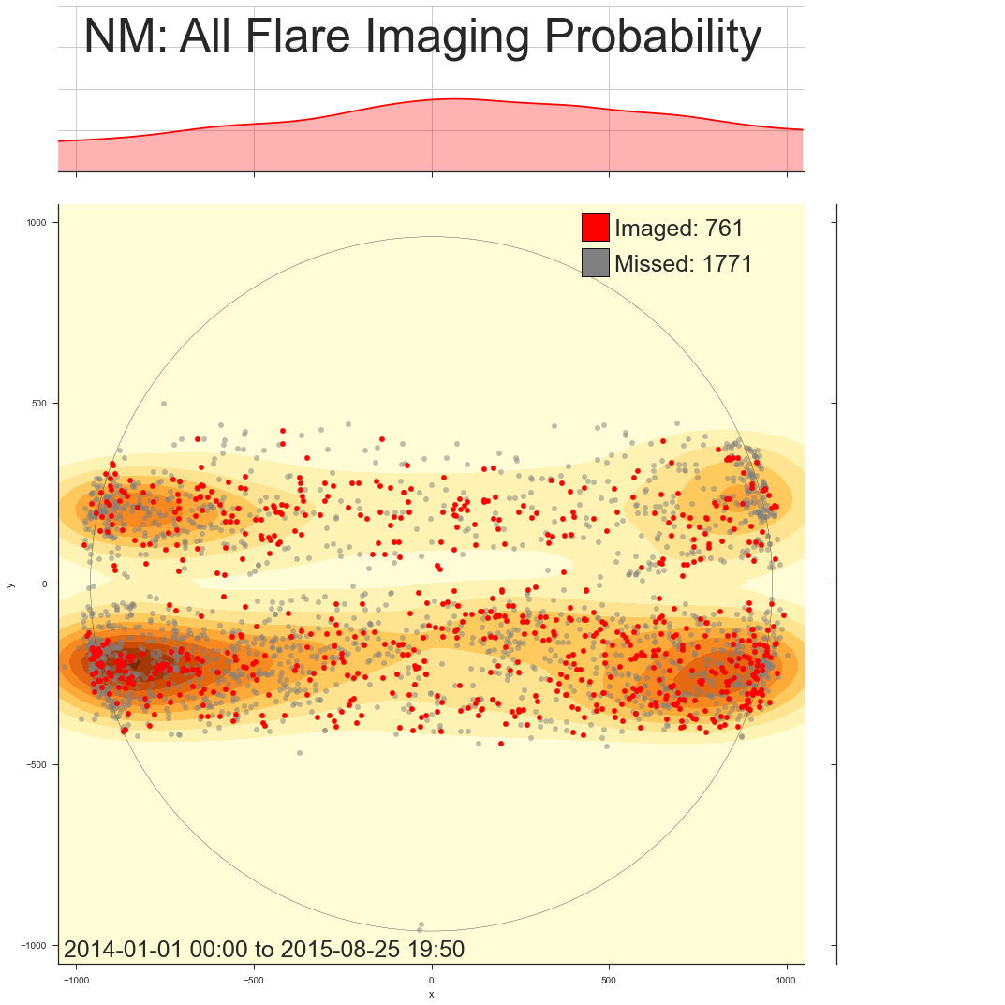
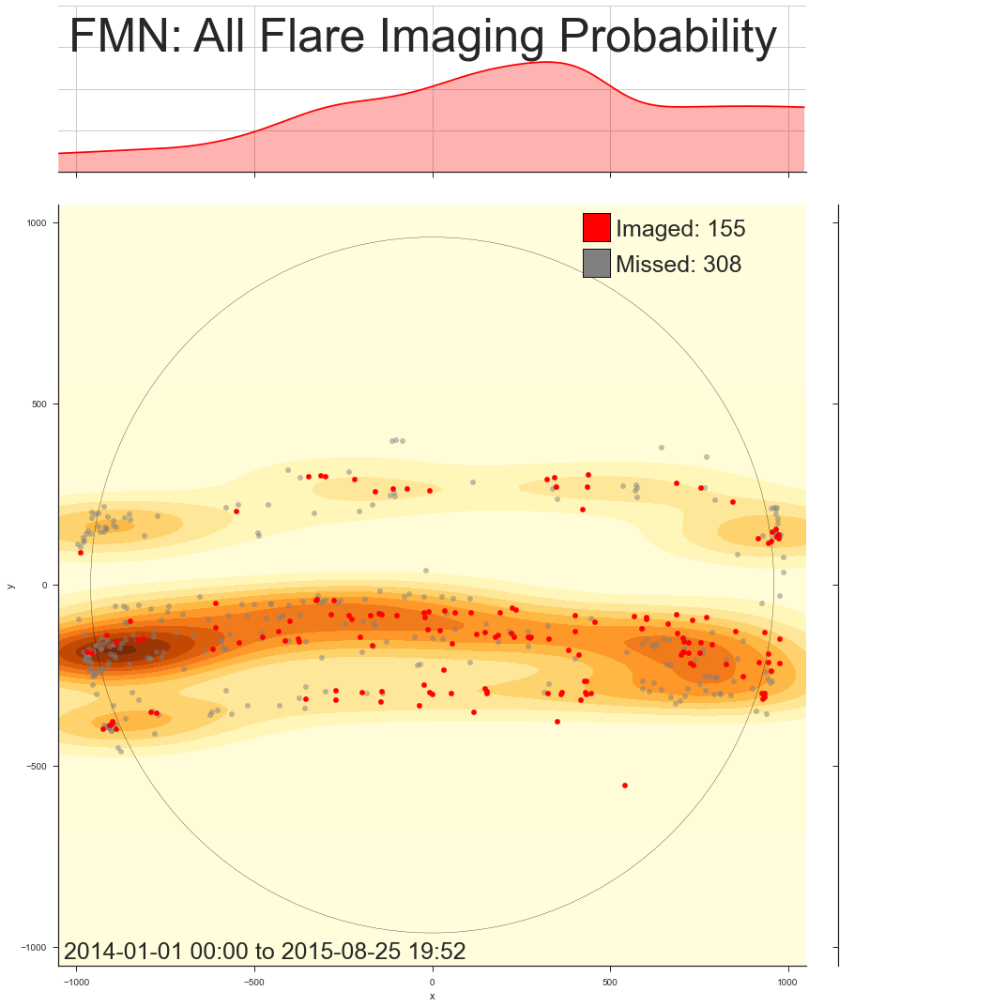
Focus mode analysis
Notes:
As the first step in my comparison of the effectiveness of XRT in imaging flares during focus mode versus normal mode. Both plots are from 2014-01-01 to the present. The figure on the left shows the probability distribution of imaging a flare along the longitudinal axis of the sun for flares that occurred while the spacecraft was in “normal mode,” which is to say, not focus mode. The figure on the right shows the same information but for flares that occurred during “focus mode normal,” which is to say, focus mode while the spacecraft was not in eclipse season. During normal focus mode, XRT captured a larger proportion of flares overall, performing especially well on the western side of the disk. From approximately -500 arcseconds an east, however, focus mode performance fell behind normal performance. These trends notwithstanding, this comparison has to be done in a more quantitative manner in order to draw any conclusions.

Slide 17
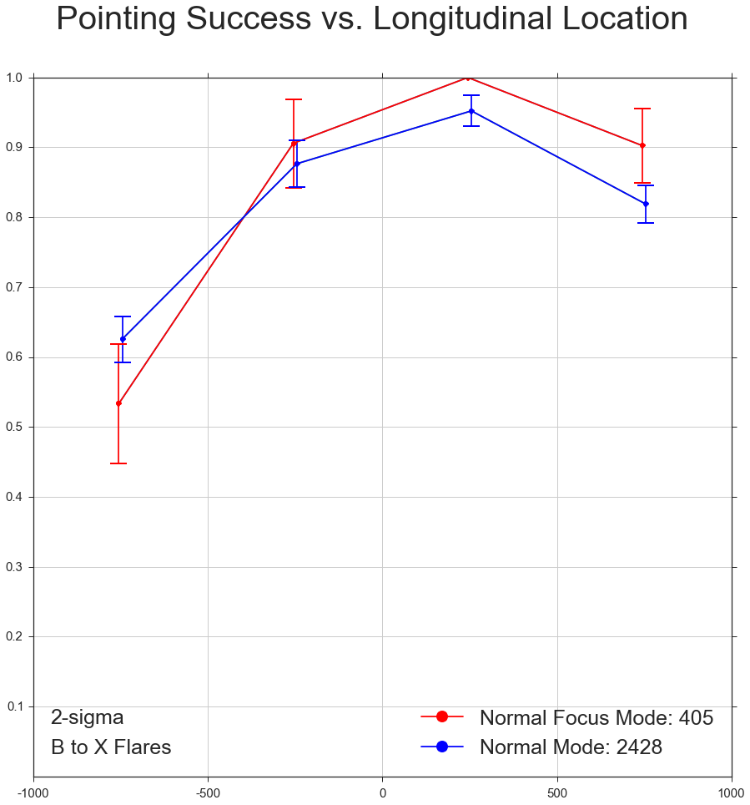
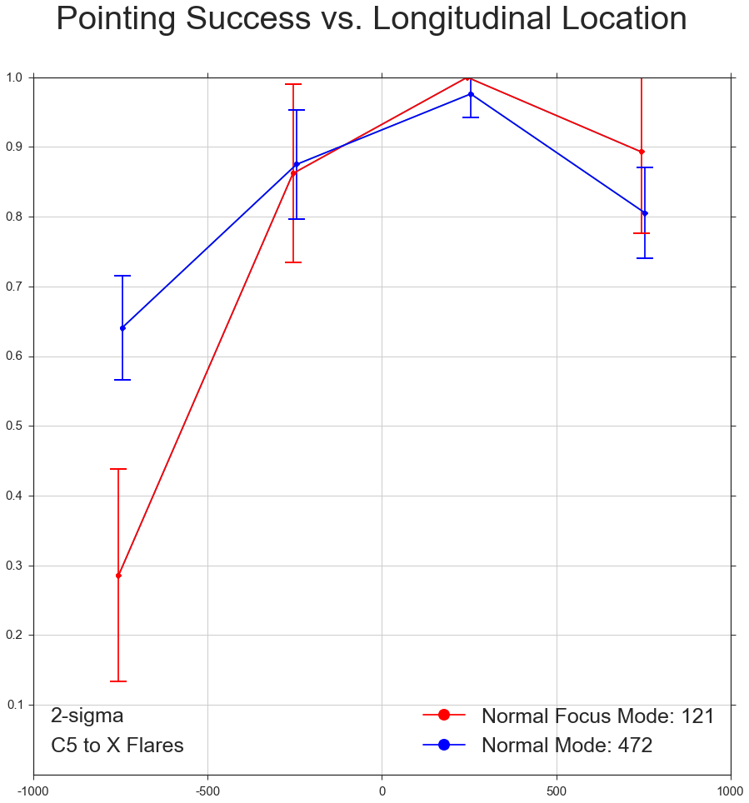
Focus mode analysis
Notes:
Using the same technique as in the STEREO analysis, I broke down by region and determined the proportion of flares in each region for which the flare occurred within the FOV of XRT. The left figure is for flares classes B through X, while the figure on the right represents the pointing performance for flares rated C5 and higher. Note that there are only 121 focus mode flares stronger than C5, so little can be said from the right hand figure beyond how there was a drop in performance on the east limb while in focus mode. The left hand figure demonstrates slight performance boosts in focus mode on the western side of the disk, while hinting at a possible drop in performance on the east limb. Regardless of these trends, there doesn’t seem to be a very large difference in focus mode versus normal mode, though the apparent drop in performance for the typically more scientifically interesting flare – classes C5 and higher – is worth noting.

Slide 18
Conclusions
Unmistakable drop in performance at east limb
Pointing failures
STEREO data wasn’t used effectively
Duty cycle is the primary cause of all FLD failures
Observing during HOP 79/130 routines would have minimal effect
Bakeouts are the second largest cause
Investigate possibility of lowering frequency and/or duration?
FLD algorithm is very effective at identifying M flares within field of view but misses C flares at edge of field
Add location-based weighting to the algorithm?
2014-2015 non-eclipse Focus Mode data suggests similar flare capturing performance to Normal Mode
Only a few hundred flares during non-eclipse FM in 2014-2015

